Slide 1
Quick Sort Algorithm with Visualization
DATA STRUCTURES CS-III
SAGAR CHHABRIYA BATCH 2K22

Slide 2
Sorting algorithms
Insertion, selection and bubble sort have quadratic worst-case performance
The faster comparison based algorithm ?
O(nlogn)
Mergesort and Quicksort

Slide 3
Quicksort Algorithm
Given an array of n elements (e.g., integers):
If array only contains one element, return
Else
  pick one element to use as pivot.
  Partition elements into two sub-arrays:
    Elements less than or equal to pivot
    Elements greater than pivot
  Quicksort two sub-arrays
  Return results

Slide 4

Quicksort
Invented by Charles Antony Richard (Tony) Hoare.
A divide and conquer approach that uses recursion.
If the list has 0 or 1 elements it is sorted
otherwise, pick any element p in the list. This is called the pivot value
Partition the into two sub lists according to values less than or greater than the pivot. (equal values go to either)
return the quicksort of the first list followed by the quicksort of the second list

Slide 5
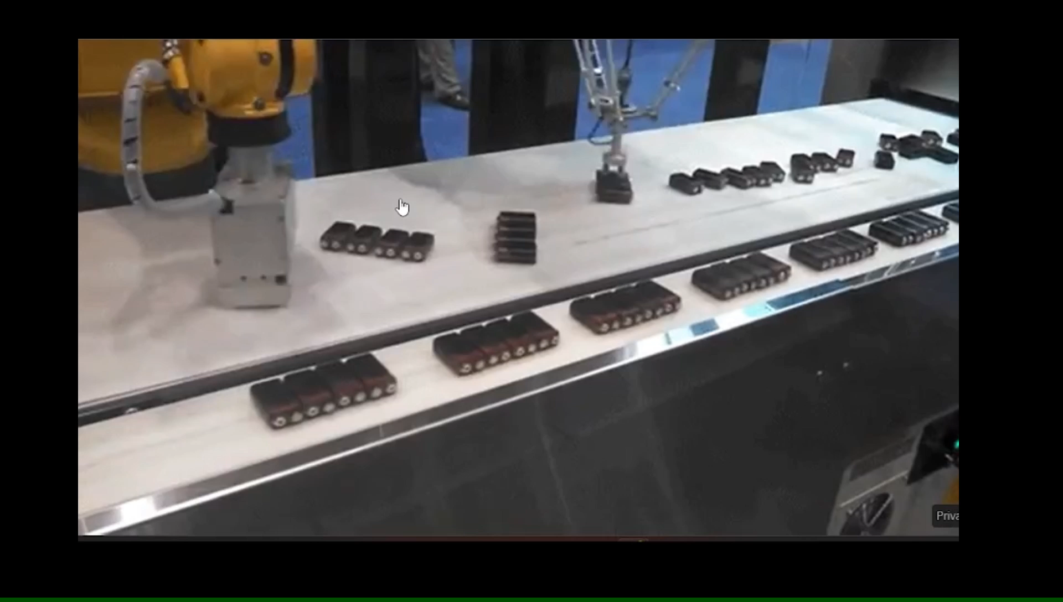
How the Divide & Conquer works?

Slide 6
Quick Sort Algorithm
QuickSort( arr[], left, right)
Step1: if arr.length equals to 0 or 1 return normally
Step2: if left < right
Step3: int mid = partition(arr, left , right)
Step4: sort(arr, left, mid-1) //recursive call
Step5: sort(arr, mid + 1, right) //recursive call
Step6: return normally

Slide 7
The partition function
partition( arr [], left, right)
step1: SET pivot = arr [left]
step2: SET start = left AND end = right
step3: Repeat while start <= end
step4: Repeat while arr[start] <= pivot
step5: SET start = start + 1 [End of step 4 loop]
step6: Repeat while arr[end] > high
SET high = high - 1 [End of step 6 loop]
step7: If start < end
[Interchange arr[start] with arr[end] ] [End of step 7 If Structure]
[End of Step 3 loop]
step8: [INTERCHANGE the arr[end] with the pivot]
Step 9 : return with value end

Slide 8
Example
We are given array of n integers to sort:
40
20
10
80
60
50
7
30
100

Slide 9
Pick Pivot Element
There are a number of ways to pick the pivot element. In this example, we will use the first element in the array:
40
20
10
80
60
50
7
30
100

Slide 10
Partitioning Array
Given a pivot, partition the elements of the array such that the resulting array consists of:
  One sub-array that contains elements >= pivot
  Another sub-array that contains elements < pivot
The sub-arrays are stored in the original data array.
Partitioning loops through, swapping elements below/above pivot.

Slide 11
pivot_index = 0
40
20
10
80
60
50
7
30
100
[0] [1] [2] [3] [4] [5] [6] [7] [8]
lowerBound
upperBound

Slide 12
While data[lowerBound] <= data[pivot]
++lowerBound
pivot_index = 0
40
20
10
80
60
50
7
30
100
[0] [1] [2] [3] [4] [5] [6] [7] [8]
lowerBound
upperBound

Slide 13
While data[lowerBound] <= data[pivot]
++lowerBound
pivot_index = 0
40
20
10
80
60
50
7
30
100
[0] [1] [2] [3] [4] [5] [6] [7] [8]
lowerBound
upperBound

Slide 14
While data[lowerBound] <= data[pivot]
++lowerBound
pivot_index = 0
40
20
10
80
60
50
7
30
100
[0] [1] [2] [3] [4] [5] [6] [7] [8]
lowerBound
upperBound

Slide 15
While data[lowerBound] <= data[pivot]
  ++lowerBound
While data[upperBound] > data[pivot]
  --upperBound
pivot_index = 0
40
20
10
80
60
50
7
30
100
[0] [1] [2] [3] [4] [5] [6] [7] [8]
lowerBound
upperBound

Slide 16
While data[lowerBound] <= data[pivot]
  ++lowerBound
While data[upperBound] > data[pivot]
  --upperBound
pivot_index = 0
40
20
10
80
60
50
7
30
100
[0] [1] [2] [3] [4] [5] [6] [7] [8]
lowerBound
upperBound

Slide 17
While data[lowerBound] <= data[pivot]
  ++lowerBound
While data[upperBound] > data[pivot]
  --upperBound
If lowerBound < upperBound
  swap data[lowerBound] and data[upperBound]
pivot_index = 0
40
20
10
80
60
50
7
30
100
[0] [1] [2] [3] [4] [5] [6] [7] [8]
lowerBound
upperBound

Slide 18
While data[lowerBound] <= data[pivot]
  ++lowerBound
While data[upperBound] > data[pivot]
  --upperBound
If lowerBound < upperBound
  swap data[lowerBound] and data[upperBound]
pivot_index = 0
40
20
10
30
60
50
7
80
100
[0] [1] [2] [3] [4] [5] [6] [7] [8]
lowerBound
upperBound

Slide 19
While data[lowerBound] <= data[pivot]
  ++lowerBound
While data[upperBound] > data[pivot]
  --upperBound
If lowerBound < upperBound
  swap data[lowerBound] and data[upperBound]
While lowerBound < upperBound , go to 1.
pivot_index = 0
40
20
10
30
60
50
7
80
100
[0] [1] [2] [3] [4] [5] [6] [7] [8]
lowerBound
upperBound

Slide 20
While data[lowerBound] <= data[pivot]
  ++lowerBound
While data[upperBound] > data[pivot]
  --upperBound
If lowerBound < upperBound
  swap data[lowerBound] and data[upperBound]
While lowerBound < upperBound , go to 1.
pivot_index = 0
40
20
10
30
60
50
7
80
100
[0] [1] [2] [3] [4] [5] [6] [7] [8]
lowerBound
upperBound

Slide 21
While data[lowerBound] <= data[pivot]
  ++lowerBound
While data[upperBound] > data[pivot]
  --upperBound
If lowerBound < upperBound
  swap data[lowerBound] and data[upperBound]
While lowerBound < upperBound , go to 1.
pivot_index = 0
40
20
10
30
60
50
7
80
100
[0] [1] [2] [3] [4] [5] [6] [7] [8]
lowerBound
upperBound

Slide 22
While data[lowerBound] <= data[pivot]
  ++lowerBound
While data[upperBound] > data[pivot]
  --upperBound
If lowerBound < upperBound
  swap data[lowerBound] and data[upperBound]
While lowerBound < upperBound , go to 1.
pivot_index = 0
40
20
10
30
60
50
7
80
100
[0] [1] [2] [3] [4] [5] [6] [7] [8]
lowerBound
upperBound

Slide 23
While data[lowerBound] <= data[pivot]
  ++lowerBound
While data[upperBound] > data[pivot]
  --upperBound
If lowerBound < upperBound
  swap data[lowerBound] and data[upperBound]
While lowerBound < upperBound , go to 1.
pivot_index = 0
40
20
10
30
60
50
7
80
100
[0] [1] [2] [3] [4] [5] [6] [7] [8]
lowerBound
upperBound

Slide 24
While data[lowerBound] <= data[pivot]
  ++lowerBound
While data[upperBound] > data[pivot]
  --upperBound
If lowerBound < upperBound
  swap data[lowerBound] and data[upperBound]
While lowerBound < upperBound , go to 1.
pivot_index = 0
40
20
10
30
60
50
7
80
100
[0] [1] [2] [3] [4] [5] [6] [7] [8]
lowerBound
upperBound

Slide 25
While data[lowerBound] <= data[pivot]
  ++lowerBound
While data[upperBound] > data[pivot]
  --upperBound
If lowerBound < upperBound
  swap data[lowerBound] and data[upperBound]
While lowerBound < upperBound , go to 1.
pivot_index = 0
40
20
10
30
7
50
60
80
100
[0] [1] [2] [3] [4] [5] [6] [7] [8]
lowerBound
upperBound

Slide 26
While data[lowerBound] <= data[pivot]
  ++lowerBound
While data[upperBound] > data[pivot]
  --upperBound
If lowerBound < upperBound
  swap data[lowerBound] and data[upperBound]
While lowerBound < upperBound , go to 1.
pivot_index = 0
40
20
10
30
7
50
60
80
100
[0] [1] [2] [3] [4] [5] [6] [7] [8]
lowerBound
upperBound

Slide 27
While data[lowerBound] <= data[pivot]
  ++lowerBound
While data[upperBound] > data[pivot]
  --upperBound
If lowerBound < upperBound
  swap data[lowerBound] and data[upperBound]
While lowerBound < upperBound , go to 1.
pivot_index = 0
40
20
10
30
7
50
60
80
100
[0] [1] [2] [3] [4] [5] [6] [7] [8]
lowerBound
upperBound

Slide 28
While data[lowerBound] <= data[pivot]
  ++lowerBound
While data[upperBound] > data[pivot]
  --upperBound
If lowerBound < upperBound
  swap data[lowerBound] and data[upperBound]
While lowerBound < upperBound , go to 1.
pivot_index = 0
40
20
10
30
7
50
60
80
100
[0] [1] [2] [3] [4] [5] [6] [7] [8]
lowerBound
upperBound

Slide 29
While data[lowerBound] <= data[pivot]
  ++lowerBound
While data[upperBound] > data[pivot]
  --upperBound
If lowerBound < upperBound
  swap data[lowerBound] and data[upperBound]
While lowerBound < upperBound , go to 1.
pivot_index = 0
40
20
10
30
7
50
60
80
100
[0] [1] [2] [3] [4] [5] [6] [7] [8]
lowerBound
upperBound

Slide 30
While data[lowerBound] <= data[pivot]
  ++lowerBound
While data[upperBound] > data[pivot]
  --upperBound
If lowerBound < upperBound
  swap data[lowerBound] and data[upperBound]
While lowerBound < upperBound , go to 1.
pivot_index = 0
40
20
10
30
7
50
60
80
100
[0] [1] [2] [3] [4] [5] [6] [7] [8]
lowerBound
upperBound

Slide 31
While data[lowerBound] <= data[pivot]
  ++lowerBound
While data[upperBound] > data[pivot]
  --upperBound
If lowerBound < upperBound
  swap data[lowerBound] and data[upperBound]
While lowerBound < upperBound , go to 1.
pivot_index = 0
40
20
10
30
7
50
60
80
100
[0] [1] [2] [3] [4] [5] [6] [7] [8]
lowerBound
upperBound

Slide 32
While data[lowerBound] <= data[pivot]
  ++lowerBound
While data[upperBound] > data[pivot]
  --upperBound
If lowerBound < upperBound
  swap data[lowerBound] and data[upperBound]
While lowerBound < upperBound , go to 1.
pivot_index = 0
40
20
10
30
7
50
60
80
100
[0] [1] [2] [3] [4] [5] [6] [7] [8]
lowerBound
upperBound

Slide 33
While data[lowerBound] <= data[pivot]
  ++lowerBound
While data[upperBound] > data[pivot]
  --upperBound
If lowerBound < upperBound
  swap data[lowerBound] and data[upperBound]
While lowerBound < upperBound , go to 1.
pivot_index = 0
40
20
10
30
7
50
60
80
100
[0] [1] [2] [3] [4] [5] [6] [7] [8]
lowerBound
upperBound

Slide 34
While data[lowerBound] <= data[pivot]
  ++lowerBound
While data[upperBound] > data[pivot]
  --upperBound
If lowerBound < upperBound
  swap data[lowerBound] and data[upperBound]
While lowerBound < upperBound , go to 1.
Swap data[upperBound] and data[pivot_index]
pivot_index = 0
40
20
10
30
7
50
60
80
100
[0] [1] [2] [3] [4] [5] [6] [7] [8]
lowerBound
upperBound

Slide 35
While data[lowerBound] <= data[pivot]
  ++lowerBound
While data[upperBound] > data[pivot]
  --upperBound
If lowerBound < upperBound
  swap data[lowerBound] and data[upperBound]
While lowerBound < upperBound , go to 1.
Swap data[upperBound] and data[pivot_index]
7
20
10
30
40
50
60
80
100
pivot_index = 4
[0] [1] [2] [3] [4] [5] [6] [7] [8]
lowerBound
upperBound

Slide 36
Partition Result
7
20
10
30
40
50
60
80
100
[0] [1] [2] [3] [4] [5] [6] [7] [8]
<= data[pivot]
> data[pivot]

Slide 37
Recursion: Quicksort Sub-arrays
7
20
10
30
40
50
60
80
100
[0] [1] [2] [3] [4] [5] [6] [7] [8]
<= data[pivot]
> data[pivot]

Slide 38
Quicksort: Worst Case
Assume first element is chosen as pivot.
Assume we get array that is already in order:
pivot_index = 0
2
4
10
12
13
50
57
63
100
[0] [1] [2] [3] [4] [5] [6] [7] [8]
lowerBound
upperBound

Slide 39
While data[lowerBound] <= data[pivot]
  ++lowerBound
While data[upperBound] > data[pivot]
  --upperBound
If lowerBound < upperBound
  swap data[lowerBound] and data[upperBound]
While lowerBound < upperBound , go to 1.
Swap data[upperBound] and data[pivot_index]
pivot_index = 0
2
4
10
12
13
50
57
63
100
[0] [1] [2] [3] [4] [5] [6] [7] [8]
lowerBound
upperBound

Slide 40
While data[lowerBound] <= data[pivot]
  ++lowerBound
While data[upperBound] > data[pivot]
  --upperBound
If lowerBound < upperBound
  swap data[lowerBound] and data[upperBound]
While lowerBound < upperBound , go to 1.
Swap data[upperBound] and data[pivot_index]
pivot_index = 0
2
4
10
12
13
50
57
63
100
[0] [1] [2] [3] [4] [5] [6] [7] [8]
lowerBound
upperBound

Slide 41
While data[lowerBound] <= data[pivot]
  ++lowerBound
While data[upperBound] > data[pivot]
  --upperBound
If lowerBound < upperBound
  swap data[lowerBound] and data[upperBound]
While lowerBound < upperBound , go to 1.
Swap data[upperBound] and data[pivot_index]
pivot_index = 0
2
4
10
12
13
50
57
63
100
[0] [1] [2] [3] [4] [5] [6] [7] [8]
lowerBound
upperBound

Slide 42
While data[lowerBound] <= data[pivot]
  ++lowerBound
While data[upperBound] > data[pivot]
  --upperBound
If lowerBound < upperBound
  swap data[lowerBound] and data[upperBound]
While lowerBound < upperBound , go to 1.
Swap data[upperBound] and data[pivot_index]
pivot_index = 0
2
4
10
12
13
50
57
63
100
[0] [1] [2] [3] [4] [5] [6] [7] [8]
lowerBound
upperBound

Slide 43
While data[lowerBound] <= data[pivot]
  ++lowerBound
While data[upperBound] > data[pivot]
  --upperBound
If lowerBound < upperBound
  swap data[lowerBound] and data[upperBound]
While lowerBound < upperBound , go to 1.
Swap data[upperBound] and data[pivot_index]
pivot_index = 0
2
4
10
12
13
50
57
63
100
[0] [1] [2] [3] [4] [5] [6] [7] [8]
lowerBound
upperBound

Slide 44
While data[lowerBound] <= data[pivot]
  ++lowerBound
While data[upperBound] > data[pivot]
  --upperBound
If lowerBound < upperBound
  swap data[lowerBound] and data[upperBound]
While lowerBound < upperBound , go to 1.
Swap data[upperBound] and data[pivot_index]
pivot_index = 0
2
4
10
12
13
50
57
63
100
[0] [1] [2] [3] [4] [5] [6] [7] [8]
lowerBound
upperBound

Slide 45
While data[lowerBound] <= data[pivot]
  ++lowerBound
While data[upperBound] > data[pivot]
  --upperBound
If lowerBound < upperBound
  swap data[lowerBound] and data[upperBound]
While lowerBound < upperBound , go to 1.
Swap data[upperBound] and data[pivot_index]
In the worst case, each partition has one empty subarray
pivot_index = 0
2
4
10
12
13
50
57
63
100
[0] [1] [2] [3] [4] [5] [6] [7] [8]
<= data[pivot]
> data[pivot]

Slide 46
Properties of Sorting Algorithms
In place?
  Do we use another data structure or not?
  Program stack typically not considered another data structure if only using O(log N) space
Comparison?
  Works by comparing the items to be sorted to each other?
  How could we not?
Stable?
  Next slide!

Slide 47
In-place or out-place?
  An in-place algorithm is an algorithm that does not need an extra space and produces an output in the same memory that contains the data by transforming the input 'in-place'. In simple, rearranges the elements within the original array itself.
  An out-of-place algorithm is the opposite of in-place and needs growing amount of memory (usually O(n) or bigger than that) to process the input into output.

Slide 48
Is the Quick Sort Stable Sorting Algorithm?
A property of sorts
If a sort guarantees the relative order of equal items stays the same then it is a stable sort
[7₁, 6, 7₂, 5, 1, 2, 7₃, -5] original data
  subscripts added for clarity
[-5, 1, 2, 5, 6, 7₁, 7₂, 7₃] sorted data
  result of stable sort

Slide 49
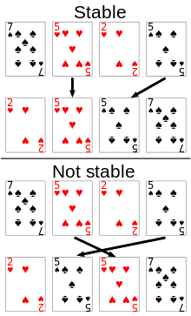

Slide 50
Knowledge is your treasure.
Enjoy the process.
Embrace mistakes.
Keep learning.
Adapt and stay strong.
Thank you for your kindness!
Catch you soon for more adventures!“
RADHE RADHE ♥

